Slide 1

Battleship
Chris Hoorn
Cody Plungis
Tiffany Pohl
Chris Hoorn Cody Plungis Tiffany Pohl

Slide 2
Intro
Classic board game
Wanted to add functionality not available in original board game
Develop better understand of TDD
Notes:
Tiffany

Slide 3
Requirements
User has choices to expand original gameplay
Size of board
Number of ships
Size of each ship
Player plays against a smart AI
AI will randomly shoot until it makes a hit
Once it finds a ship, it continues to shoot at it until the ship is sunk
Easy to understand and use
Well laid out user interface
Useful help menus
Ability to use in English or German
Can change throughout game setup
Notes:
Tiffany

Slide 4
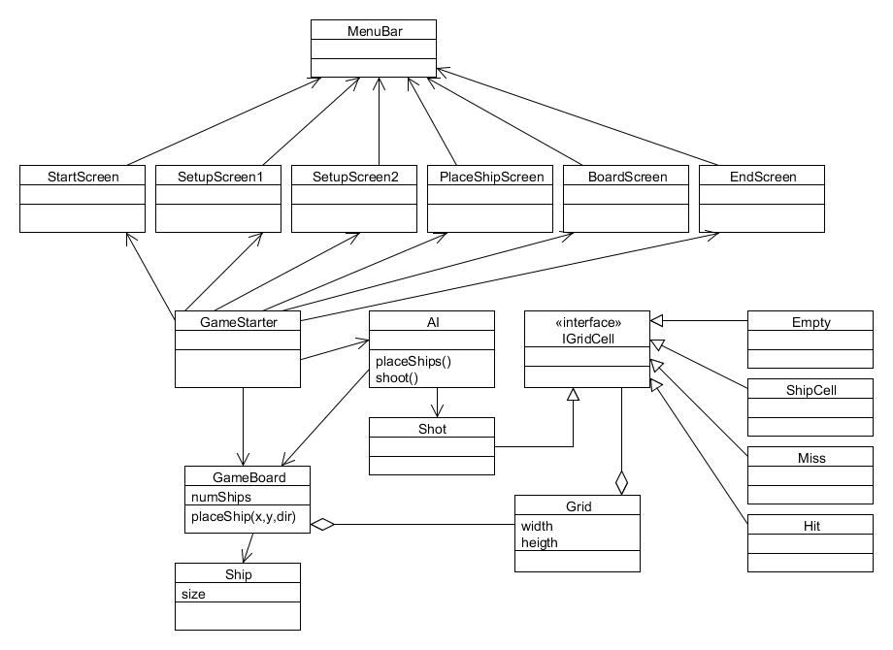
Solution
Notes:
Cody

Slide 5
TDD
Test cases
GUI user scenarios
Write Tests
Add Function
Revise Past Tests
Run Tests
Interpret Result
Notes:
Cody+Chris

Slide 6
Metrics Used
Metric | Tracking Method | Min | Max | Ave
# of Unit Tests and verified visual user stories | Cumulative tests each week counted by hand | - | - | Increasing
Test Cases per Public Method | Counted Test Cases ÷ Counted Public Methods | - | - | >1.5
Lines of Code per Method | Tracked by Eclipse Metrics | 1 | 50 | <20
Lines of Code | Cumulative lines each week counted by Eclipse Metric (number of non-comment or blank lines) | - | - | Increasing
Number of Parameters | Tracked by Eclipse Metrics | 0 | 6 | <3
Notes:
Chris

Slide 7
Metric Tracking
Metric | Week 3 | Week 4 | Week 5
# of Unit Tests and verifications | 71 | 82 Backlog: 3 | 90
Test Cases per Public Method | 71/54 = 1.31 | 82/61 = 1.35 | 90/56 = 1.61
Lines of Code per Method | Max: 36 Ave: 5.26 | Max: 36 Ave: 5.9 | Max: 69 Ave: 6.8
Lines of Code | 1265 | 1537 | 1878
Number of Parameters | Max: 4 Ave: 0.331 | Max: 4 Ave: 0.421 | Max: 6 Ave: 0.47
Notes:
Chris

Slide 8
Demo
Notes:
Cody

